Slide 1


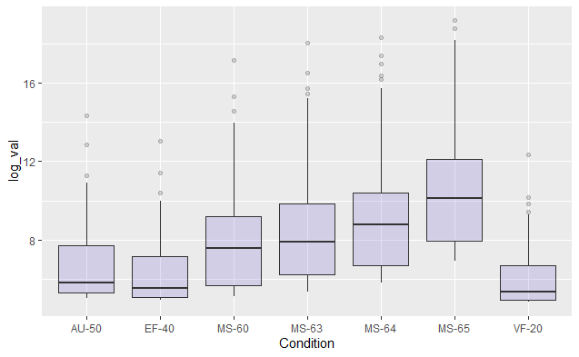
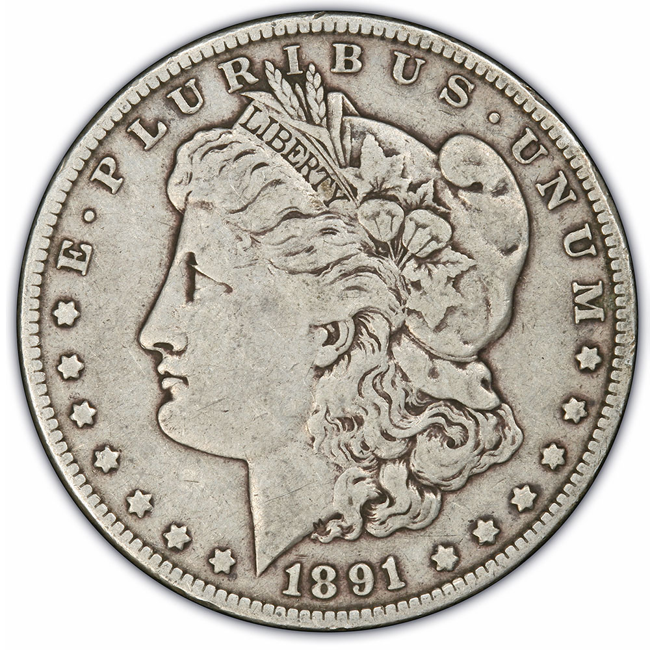
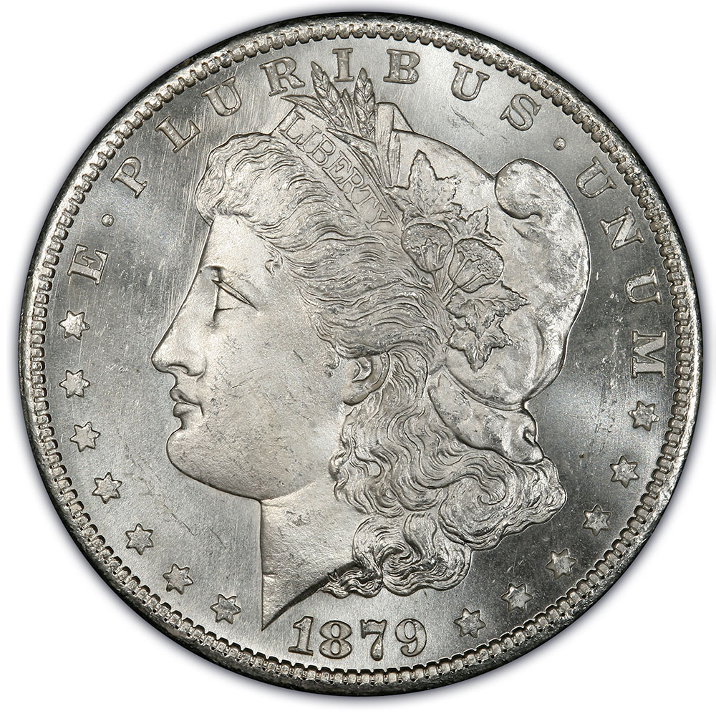
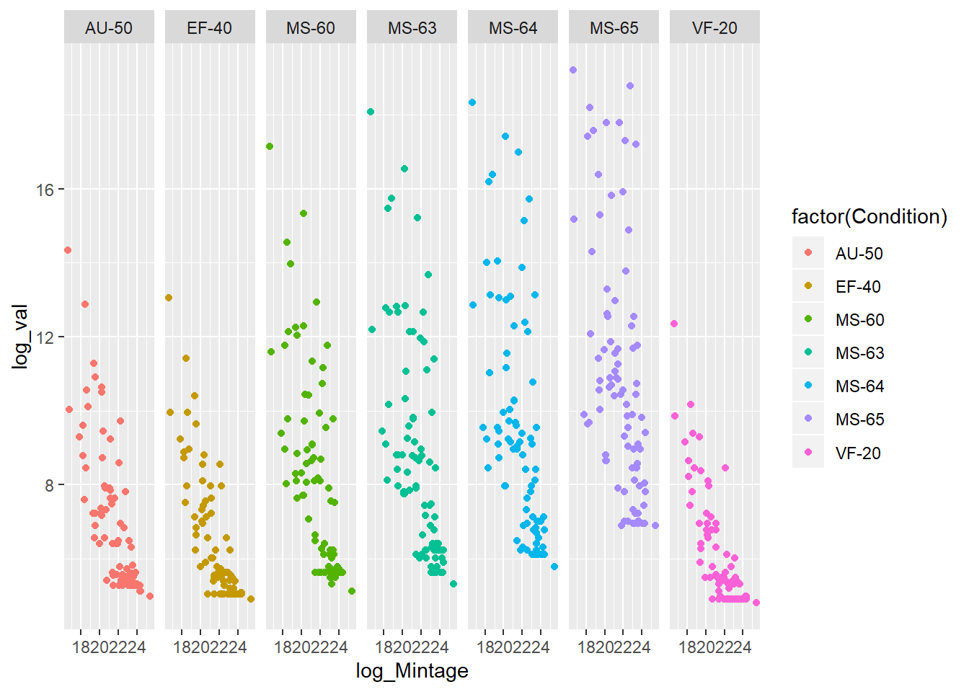
How Rarity and Condition Influence the Value of Collectible Coins
Ezoua Bekro and Angela Diamidia
Advisor: Dr. Tyler Cook
Department of Mathematics & Statistics
University of Central Oklahoma
Motivation
Our goal is to determine how rarity and condition influence the worth of the coins.
Coins are graded based on their condition at different levels: VF :Very Fine, EF: Extra Fine, MS: Mint State, AU: About Uncirculated. Here are some pictures of the Morgan Silver Dollar in different conditions (Very Fine and Mint State Condition):
Results
Summary Statistics
Results
Condition | Mean | Standard Deviation
VF-20 | 169.2826 | 562.9580
EF-40 | 262.1957 | 938.3521
AU-50 | 549.5326 | 2301.9139
MS-60 | 3123.2500 | 15845.5803
MS-63 | 6621.0326 | 31040.8044
MS-64 | 11210.2717 | 42355.6584
MS-65 | 31920.1087 | 93533.0840
There is a greater variability for MS Condition’s log_value as well as larger outliers.
Conclusions and Future Work
By using a Multiple Linear Regression Analysis, it was determined that the differences between the baseline VF-20 and MS-60, MS-63, MS-64 and MS-65 were significant with p-values less than 0.05.
The value of a coin is higher for the MS conditions.
Furthermore, it was determined that the interactions between Mintage, MS-60, MS-63, MS-64 and MS-65 were statistically significant with p-values less than 0.05.
The change in Mintage is explained by the different conditions.
Mintage was statistically significant (p = 3.21e-10). That is the Value is higher when the Mintage is lower.
For future work, we can look at other predictors such as the different Mints and they influence our model. We can also use different coins other than the Morgan Silver Dollar. Finally, we can look at other data sources such as Auctions.
Methodology
Data Collection
The book that we got the values from is known as "The Red Book" and here is the reference: Yeoman, Richard S. A guide book of United States coins. Whitman Pub., 2020.
Our research is essentially based on the Morgan Silver Dollar (1878-1921)
The data was summarized by calculating the mean and the standard deviation of Value for each condition.
Data Transformation
In order to fit the model, we transformed the variables Mintage and Value by using logarithm base 2 (log2).
We decided to transform our data using logarithm base 2 because our original data was exponential and also because the adjusted R-squared was too small.
Creation of Model
We performed a Multiple Linear Regression to predict Value with Condition, Mintage and the interaction between Condition and Mintage.
It can be observed that as Mintage decreases, the Value is increasing.
Regression
Adjusted R² = 0.5959.
59.59% the variability in Value is explained by Condition and Mintage.

